Slide 1

Workshop Title
Client Name : Program Name
Presented by:
Your Name
Event Date
Your Logo

Slide 2
Workshop Title
AGENDA
Discovering Our Strengths (Strengths Portrait)
What Drives Our Team (SDI part 1)
Managing Our Strengths (Strengths Portrait)
Overdoing Our Strengths (Overdone Strengths Portrait)
Our Team Facing Conflict (SDI part 2)
Team Effectiveness (Team Portrait Cards)

Slide 3
1
Discovering Our Strengths
STRENGTHS PORTRAIT
Strengths are behaviors. They are actions you choose with the intent of producing results for yourself, others, and your organization.

Slide 4

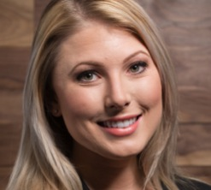
Introducing Your Strengths
Your Name
Your top strength, with an example of how you used
it recently

Slide 5
Becoming More Effective
Effectiveness
Appreciation
Acceptance
Understanding
Awareness

Slide 6
2
What Drives Our Team
STRENGTH DEPLOYMENT INVENTORY (SDI)
Behavior is driven by motives
Motives change in conflict
Strengths can be overdone
Filters influence perception

Slide 7


Strengths
Motives
are what people see
are harder to see
Your motives anchor
your strengths.
They are the reason why you do what you do.
Like a buoy, strengths shift based on the environment.

Slide 8
3
Primary Motives
We are motivated by concerns for...
PEOPLE
...wanting to help others
PERFORMANCE
...wanting to achieve results
PROCESS
...wanting to establish order

Slide 9
Your Motivational Value System
Your blend or priority of the three motives...
0
100
52
0
100
22
0
100
26
Your three scores
from SDI Condition 1 (Going Well)
Three scales
from 0 to 100

Slide 10
Motivational Value System
= MVS
A system of motives and values that drives your use of strengths when things are going well.

Slide 11

The SDI Triangle
PEOPLE
0
100
100
Combining the
three scales creates...
PERFORMANCE
0
0
PROCESS
100

Slide 12
PEOPLE
MVS
26
Locating
Your MVS Dot
52
PERFORMANCE
22
PROCESS
The intersection is the location of your MVS dot.

Slide 13
PEOPLE
RED-BLUE
BLUE
RED
The Seven
MVS Types
PERFORMANCE
HUB
BLUE-GREEN
RED-GREEN
Where we get our focus
and priorities
No best or worst place to be
It is not about competence
It is about the filter through
which we view the world
GREEN
Over 5,000 possible MVS dots
7 MVS regions group all the
MVS dots that are similar
MVS types are not boxes with walls
Some MVS dots are close to borders
PROCESS

Slide 14

Blue MVS
Altruistic-Nurturing
People who are motivated by the protection, growth, and welfare of others. They have a strong desire to help others who can genuinely benefit.
PEOPLE
PEOPLE
PERFORMANCE
PROCESS
Altruistic – unselfish concern for the welfare of others
Nurturing – protecting, supporting, and encouraging others

Slide 15

Red MVS
Assertive-Directing
People who are motivated by task accomplishment and achieving results. They have a strong desire to set goals, take decisive actions, and claim earned rewards.
PEOPLE
PERFORMANCE
PERFORMANCE
PROCESS
Assertive – confidently self-assured and forceful
Directing – giving authoritative instruction or guidance

Slide 16

Green MVS
Analytic-Autonomizing
People who are motivated by meaningful order and thinking things through. They have a strong desire to pursue independent interests, to be practical, and to be fair.
PEOPLE
PERFORMANCE
PROCESS
PROCESS
Analytic – methodical examination of structures or information
Autonomizing – maintaining objective independence, self-governing

Slide 17

Red-Blue MVS
Assertive-Nurturing
People who are motivated by the maximum growth and development of others. They have a strong desire to direct, persuade, or lead others for the benefit of others.
PEOPLE
PEOPLE
PERFORMANCE
PERFORMANCE
PROCESS
Assertive – confidently self-assured and forceful
Nurturing – protecting, supporting, and encouraging others

Slide 18

Red-Green MVS
Judicious-Competing
People who are motivated by intelligent assertiveness and fairness in competition. They have a strong desire to develop strategy and assess risks and opportunities.
PEOPLE
PERFORMANCE
PERFORMANCE
PROCESS
PROCESS
Judicious – having, showing, or being done with good judgment or sense
Competing – striving to gain or win by doing something better than others

Slide 19

Blue-Green MVS
Cautious-Supporting
People who are motivated by developing self-sufficiency in self and others. They have a strong desire to analyze the needs of others and to help them help themselves.
PEOPLE
PEOPLE
PERFORMANCE
PROCESS
PROCESS
Cautious – careful to avoid potential problems or dangers
Supporting – providing encouragement, comfort, and emotional help

Slide 20

Hub MVS
Flexible-Cohering
People who are motivated by flexibility and adapting to others or situations. They have a strong desire to collaborate with others and to remain open to different viewpoints and options.
PEOPLE
PEOPLE
PERFORMANCE
PERFORMANCE
PROCESS
PROCESS
Flexible – able to respond to changing circumstances and conditions
Cohering – bringing together to form a united whole

Slide 21
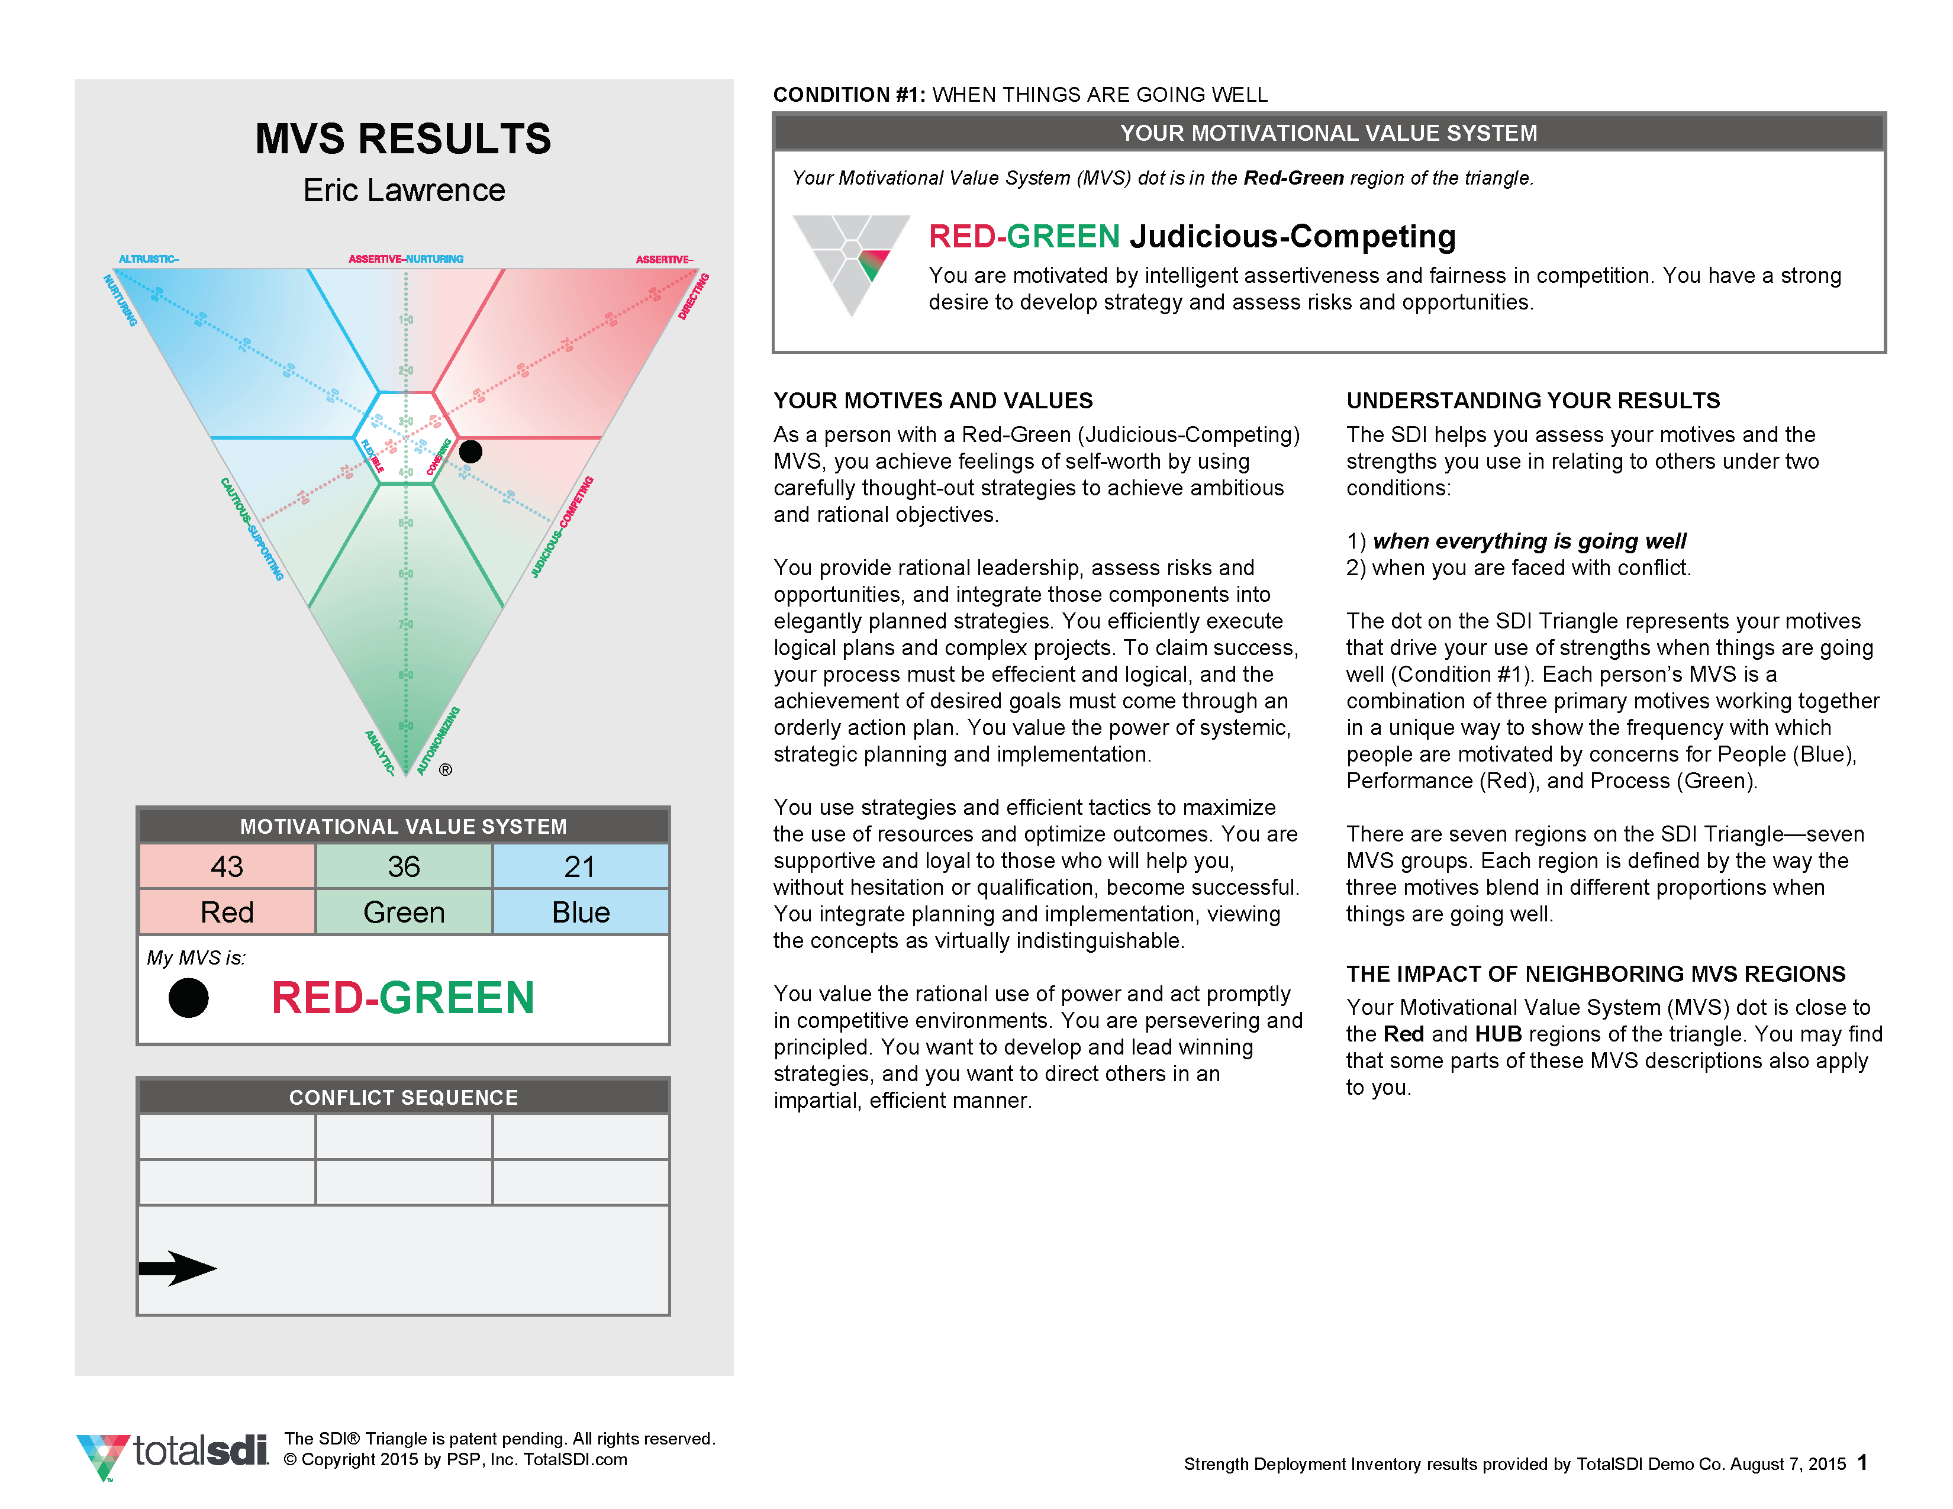
Your MVS
Results
Notes:
FACILITATOR: Place your own MVS report

Slide 22
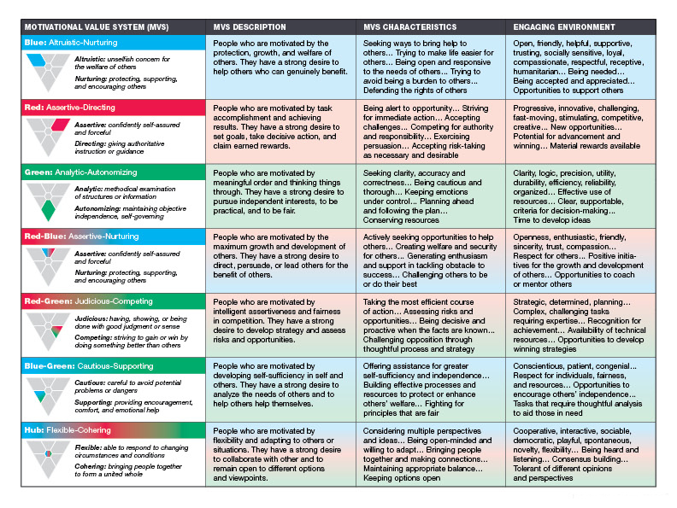
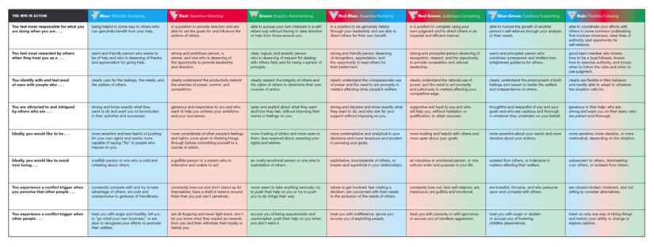
More About
Your MVS
Page 2
Pages 3-4
Notes:
FACILITATOR: Change page numbers to align with the interpretive materials you are providing in the session

Slide 23
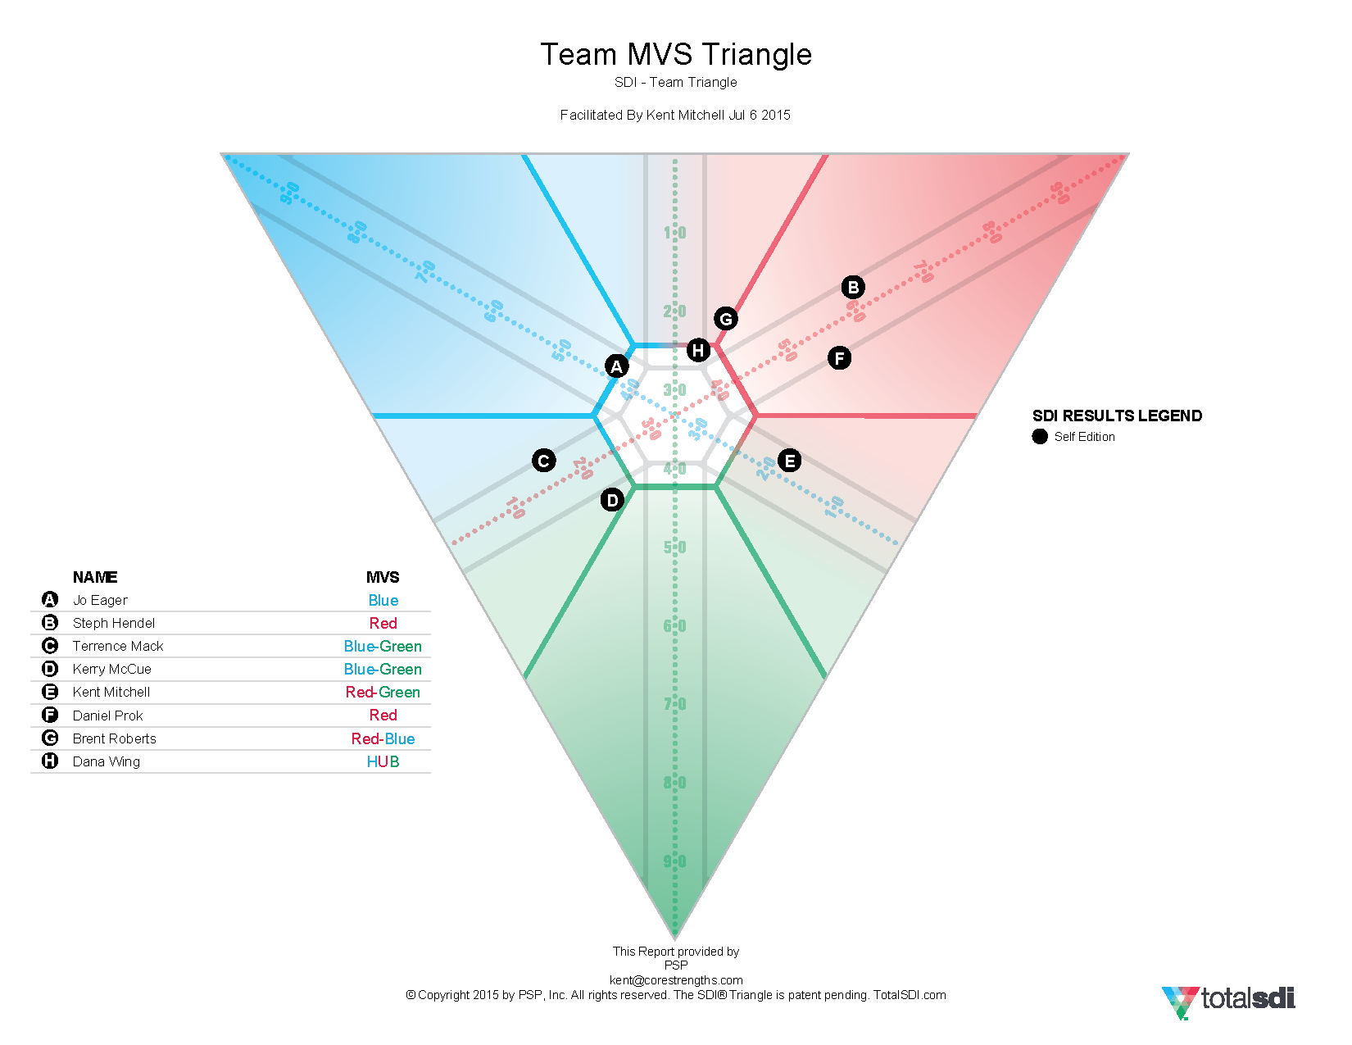
Our Team
SDI Triangle
What does this suggest about our team?
What drives us?
What do we value?
Notes:
FACILITATOR: Place the team MVS triangle

Slide 24

Living Triangle:
MVS Groups
(MVS Color)
A meaningful compliment to us would be…
We are most engaged working in teams when…
If we are not engaged, it’s because we (do/don’t)…

Slide 25
Blue MVS
Altruistic-Nurturing
A meaningful compliment to us would be…
We are most engaged working in teams when…
If we are not engaged, it’s because we (do/don’t)…
PEOPLE
PEOPLE
PERFORMANCE
PROCESS

Slide 26
Red MVS
Assertive-Directing
A meaningful compliment to us would be…
We are most engaged working in teams when…
If we are not engaged, it’s because we (do/don’t)…
PEOPLE
PERFORMANCE
PERFORMANCE
PROCESS

Slide 27
Green MVS
Analytic-Autonomizing
A meaningful compliment to us would be…
We are most engaged working in teams when…
If we are not engaged, it’s because we (do/don’t)…
PEOPLE
PERFORMANCE
PROCESS
PROCESS

Slide 28
Red-Blue MVS
Assertive-Nurturing
A meaningful compliment to us would be…
We are most engaged working in teams when…
If we are not engaged, it’s because we (do/don’t)…
PEOPLE
PEOPLE
PERFORMANCE
PERFORMANCE
PROCESS

Slide 29
Red-Green MVS
Judicious-Competing
A meaningful compliment to us would be…
We are most engaged working in teams when…
If we are not engaged, it’s because we (do/don’t)…
PEOPLE
PERFORMANCE
PERFORMANCE
PROCESS
PROCESS

Slide 30
Blue-Green MVS
Cautious-Supporting
A meaningful compliment to us would be…
We are most engaged working in teams when…
If we are not engaged, it’s because we (do/don’t)…
PEOPLE
PEOPLE
PERFORMANCE
PROCESS
PROCESS

Slide 31
Hub MVS
Flexible-Cohering
A meaningful compliment to us would be…
We are most engaged working in teams when…
If we are not engaged, it’s because we (do/don’t)…
PEOPLE
PEOPLE
PERFORMANCE
PERFORMANCE
PROCESS
PROCESS

Slide 32
MVS Appreciation
(MVS Color)
 | Appreciate or Admire | Don’t Appreciate | How to Influence
B
R
G
H
4 MVS Groups
= Strongly agree
Disagree
Relocate
Add Information
= Question

Slide 33
Our Team
SDI Triangle
What does
this say about
our team?
What could trigger conflict in our team?
How much are we concerned about people, performance, and process?
What are our potential blind spots? What could that cost us?
Notes:
FACILITATOR: Place the team MVS triangle again

Slide 34
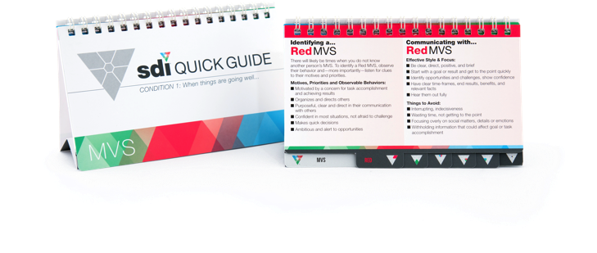
Appreciating Others’ MVS
Focus on Motives
Adjust your Filters
Use the SDI Quick Guide

Slide 35

Effective
Communication
Refer to your MVS page
Do the “Effective Style & Focus” points offer good advice to others about how to work with you?
Read the “Things to Avoid” points. How do you react when others approach you in these ways?
Refer to the page
for the MVS of a
key relationship.
Read the “Effective Style & Focus” points and “Things to Avoid” points.
What could you do (or not do) to work more effectively with this person?

Slide 36

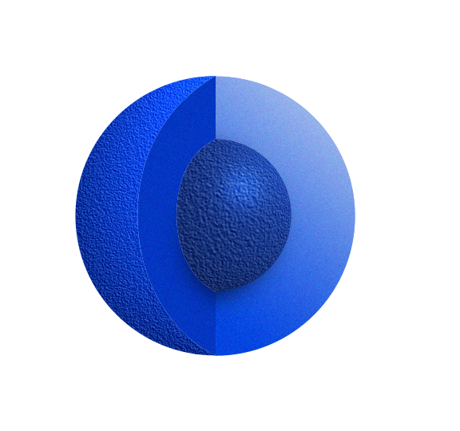
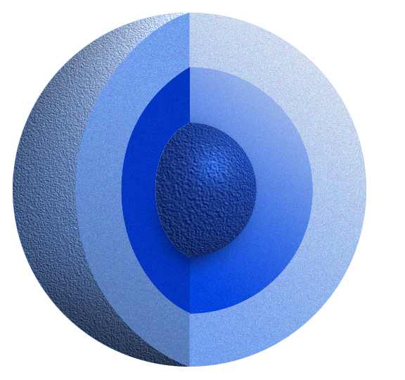
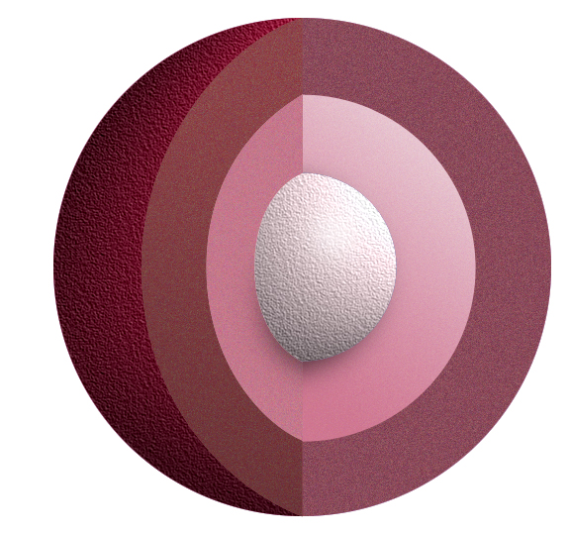
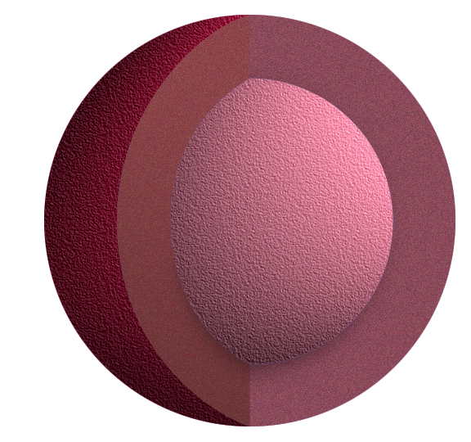

Understanding Perceptions
You see yourself based on…
They see you based on…
BEHAVIORS
BEHAVIORS
INTENTIONS
INTENTIONS
MOTIVES
MOTIVES
…why you are trying to do it.
…how they react to what you do.

Slide 37
The Impact of Filters
Just as a book can’t be judged by its cover, a motive can’t be judged by a strength.
We focus on things that help us fulfill our motives and screen out things that do not.
Strengths can be used for
many different reasons.

Slide 38
Strengths and Reasons
FAIR
FAIR
FAIR
BLUE: so people get what they need
RED: to achieve a legitimate win
GREEN: to maintain objectivity
HUB: to build consensus respectfully
FAIR
Notes:
FACILITATOR: Replace « (resource) » with the name of the material(s) you are providing which contain the complete Strengths and Reasons tables: Working With SDI (#3400), Interpretive Guide (#1018), Paper Strengths Portrait (#1113), Strengths Portrait Personalized Report (#1213)
DELETE Customize Icon

Slide 39
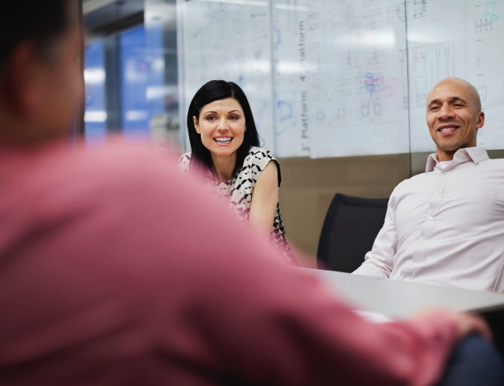
The Art of Borrowing
Understand...
Your own motives
Other’s motives
Clearly know...
The results you want
The results others want
Choose the right strength to...
Improve relationships
Produce good outcomes
You can borrow
any of the 28
strengths effectively

Slide 40
How To Borrow
F | Frequency
D | Duration
I | Intensity
C | Context
Strengths may work better if modified in one of these four areas.

Slide 41



Conflict
Triggers
Green Overdone Strengths | Suspicious
Cold | Rigid
Obsessed | Unbending
Distant | Stubborn
Ann
Joe
Rob
Write your name (in MVS color) on three sticky-notes.
Identify the top three overdone strengths in others that trigger conflict for you.
Place your notes in the boxes
for those overdone strengths.
Ted
Kim
Joe
Rob

Slide 42


Overdone Strengths
Green Overdone Strengths | Suspicious
Cold | Rigid
Obsessed | Unbending
Distant | Stubborn
Ann
Ann
Joe
Rob
Write your name (in MVS color) on three notes.
Identify your top three
overdone strengths.
Place your notes in
the boxes for those
overdone strengths.
Sam
Nat
Rob
Ted
Ted
Kim
Joe
Rob
Ann
Ted

Slide 43
Perceived or Actual?
Effectiveness can be improved
by adjusting your strengths
...or making changes in perception.

Slide 44
Changing Perceptions
Perceived Overdone Strength | Positive Intent?
Smothering | Trying to be Helpful
Aggressive | Trying to be Competitive
Distant | Trying to be Reserved
Intrusive | Trying to be Sociable
What is the
positive intent behind overdone strengths?

Slide 45
Managing Your
Overdone Strengths
To prevent conflict from overdone strengths:
OR
OR
Adjust Frequency, Duration, Intensity, or Context | Choose a different strength | Choose a supporting strength that will prevent overdoing
Page 28
Notes:
FACILITATOR: Change page number to align with the interpretive materials you are providing in the session

Slide 46
5
Our Team Facing Conflict
STRENGTH DEPLOYMENT INVENTORY (SDI)
Part 2
Behavior is driven by motives
Motives change in conflict
Strengths can be overdone
Filters influence perception

Slide 47

The Cost$
of Conflict
How much can you find?

Slide 48
Time Spent
Loss of Business or Reputation
Turnover and Recruitment / Onboarding
Missed Opportunities (loss of sales)
Lack of Collaboration
Absenteeism & Presenteeism
Legal and Administrative
Bad Decisions
Sabotage
Stress / Health Impact
Strained Personal Relationships
Safety / Risk Management
Lack of Engagement / Damaged Morale
The Cost$
of Conflict
Did you consider...

Slide 49
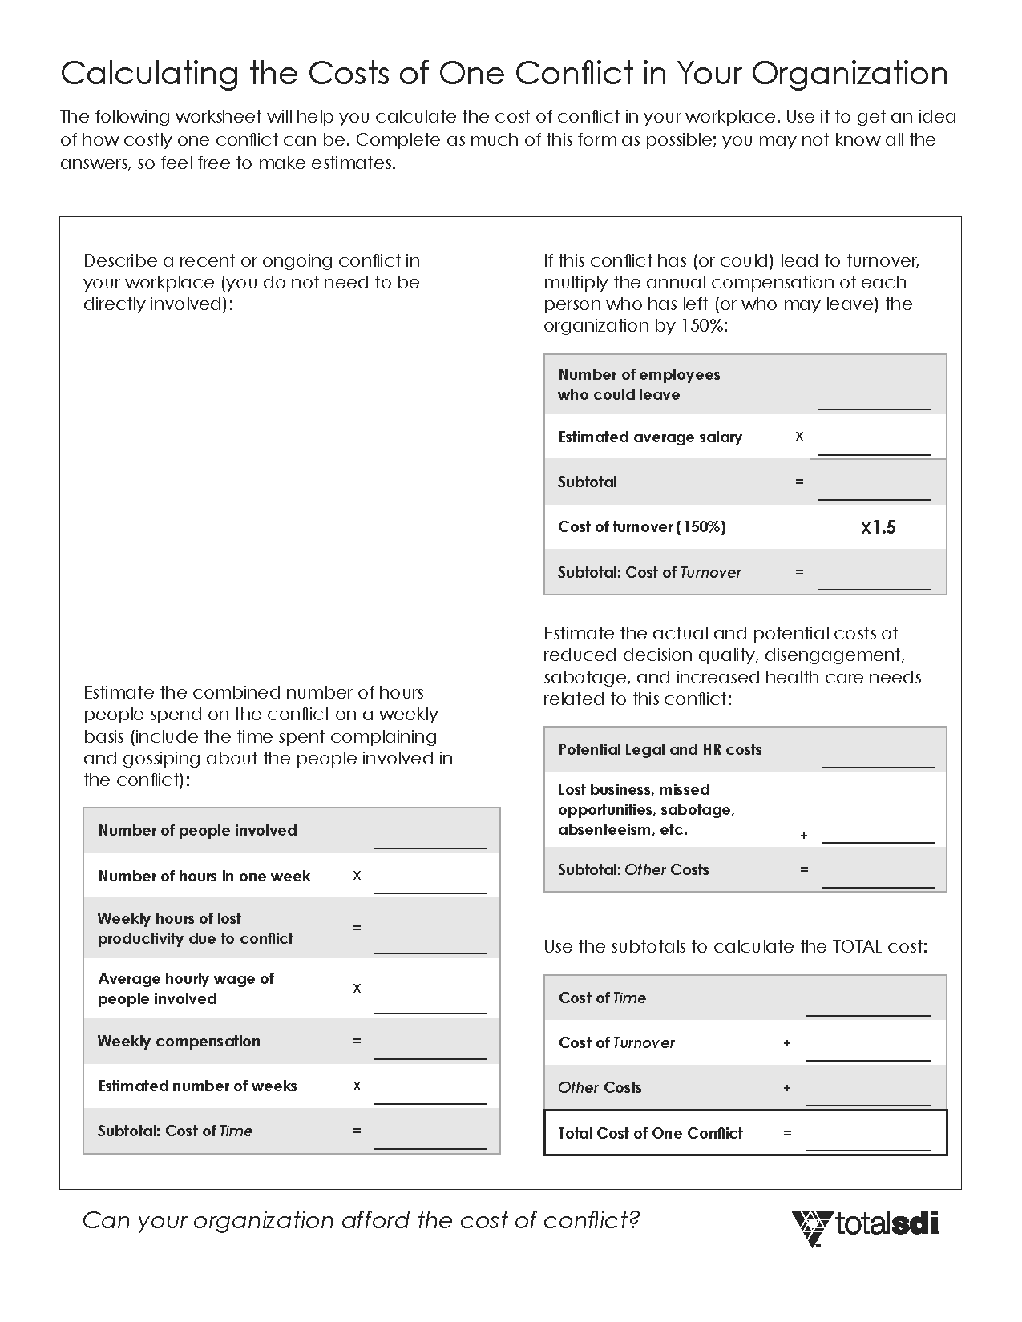

The Cost$
of Conflict
Calculate a workplace conflict

Slide 50
Opposition vs. Conflict
Opposition is
about disagreement
Opposition
can be productive
People go into
conflict only about
things that are
important to them
Conflict is about
a threat to values
Conflict is
usually unproductive
Conflict provides an opportunity to learn what matters to people and
a chance to make it right

Slide 51


How Does Conflict Start?
Threat of Overdone Strengths:
Threat to Strengths:
Threat to
Motives:
Strength is restricted
from use
Strength is disregarded
or insulted
Feeling forced to
use a non-preferred strength
BLUES might feel conflict
if people are mistreated.
REDS might feel conflict if a task is not getting done.
GREENS might feel conflict if order is disrupted.
HUBS might feel conflict
if flexibility is restricted.
Frequency
Duration
Intensity
Context

Slide 52
The SDI Measures Motives Under Two Conditions
When things are going well (Motivational Value System)
When faced with conflict
(Conflict Sequence)
SDI explains why
we do what we do.

Slide 53
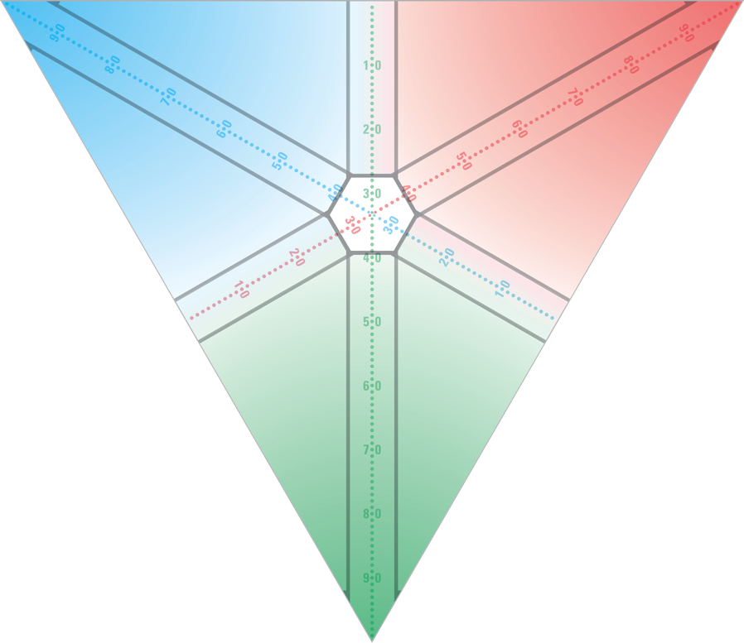
Motives Under
2 Conditions
CONDITION 2
CONDITION 1
The
“Arrowhead”
The
“Dot”
Conflict
SEQUENCE
3 motives
working in ORDER
Motivational Value
SYSTEM
3 motives
working TOGETHER

Slide 54
3
Motives in Conflict
Wanting to...
ACCOMMODATE
...and preserve harmony
ASSERT
...and prevail over obstacles
ANALYZE
...and slow things down

Slide 55
Your Conflict Sequence
The order of the three motives...
0
100
16
0
100
54
0
100
30
Your three scores
from SDI Condition 2 (Conflict)
Three scales
from 0 to 100

Slide 56
ACCOMMODATE
Locating Your
CS Arrowhead
30
54
ASSERT
16
The Arrowhead
is connected to the Dot by a line.
ANALYZE
The intersection is the point of your Arrowhead.

Slide 57
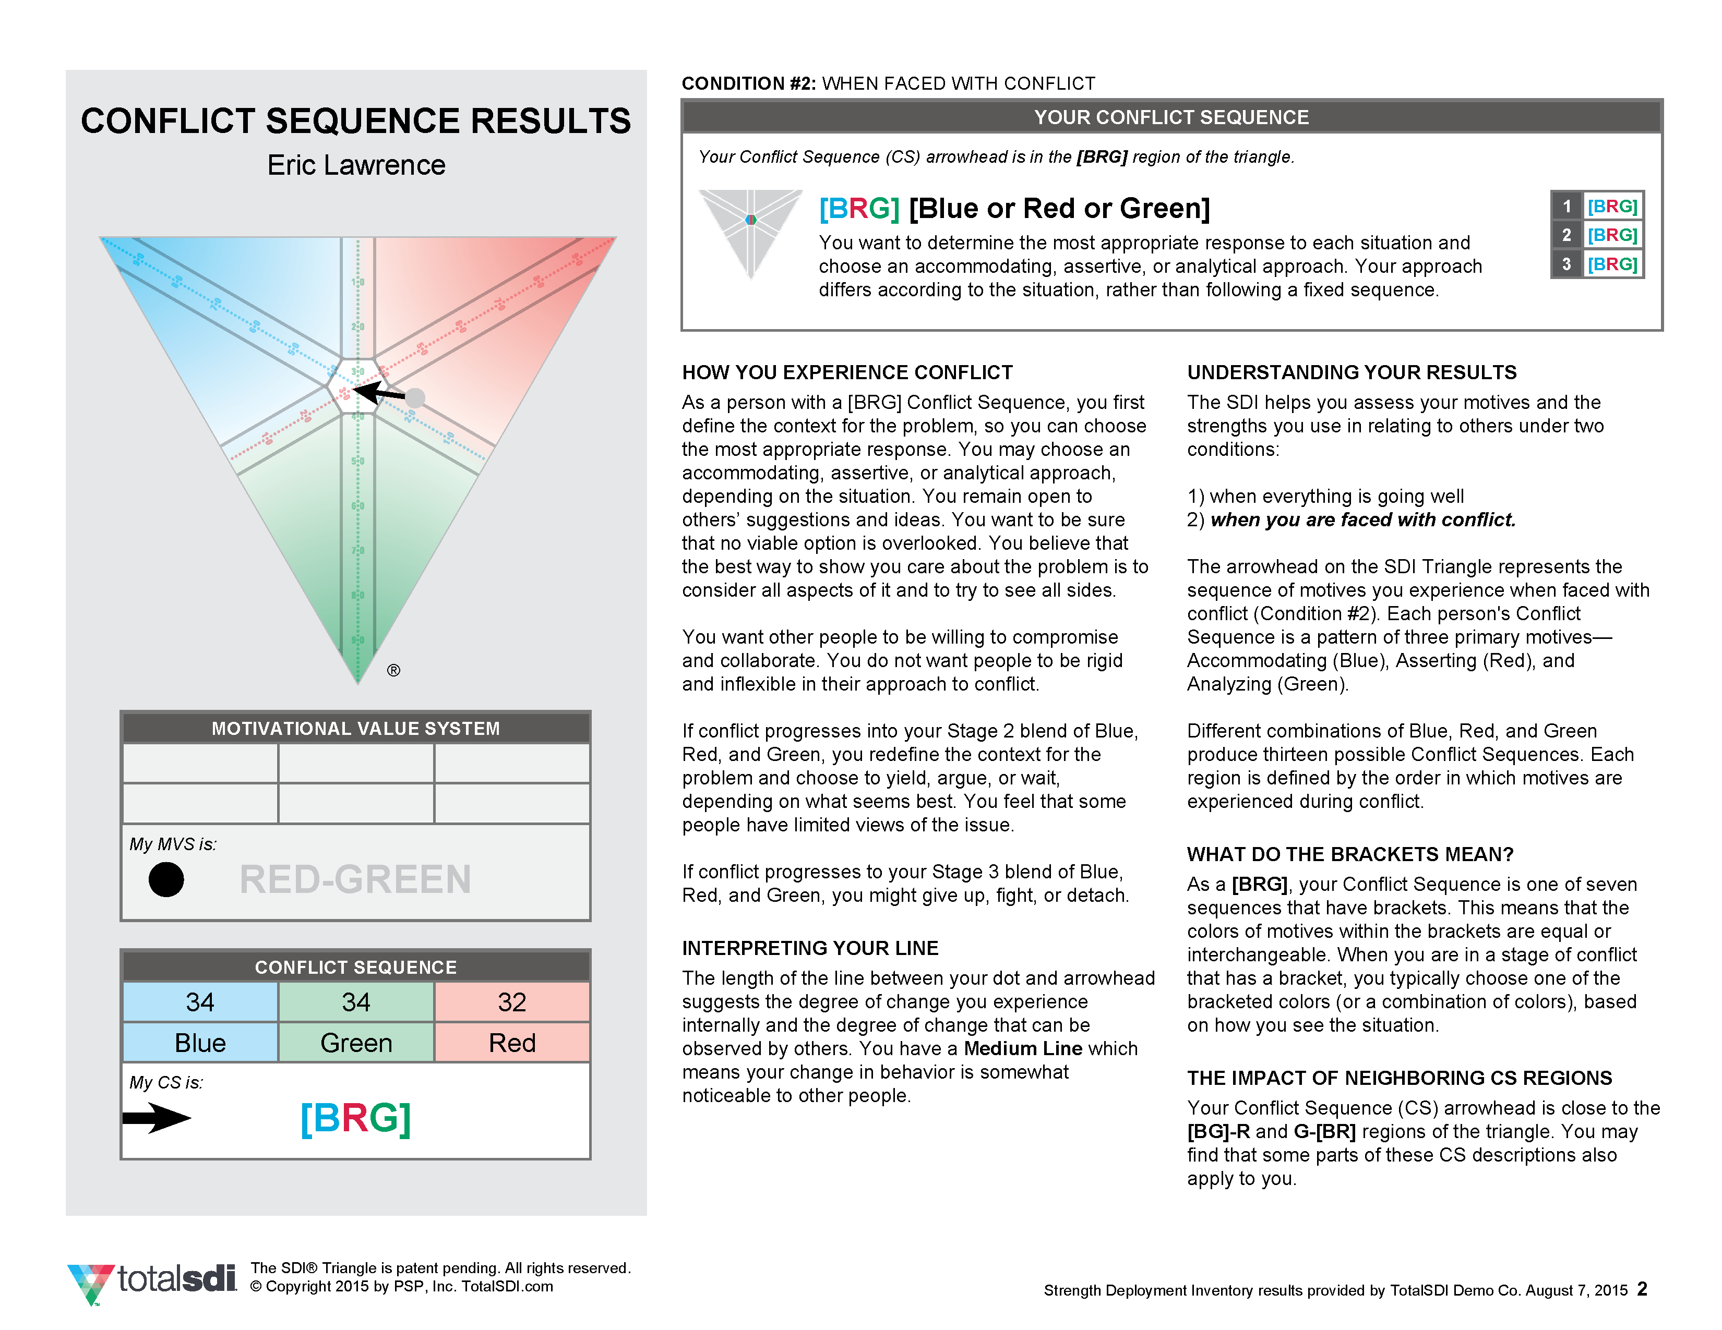
SDI Conflict
Results
Notes:
FACILITATOR: Place your SDI Conflict result

Slide 58
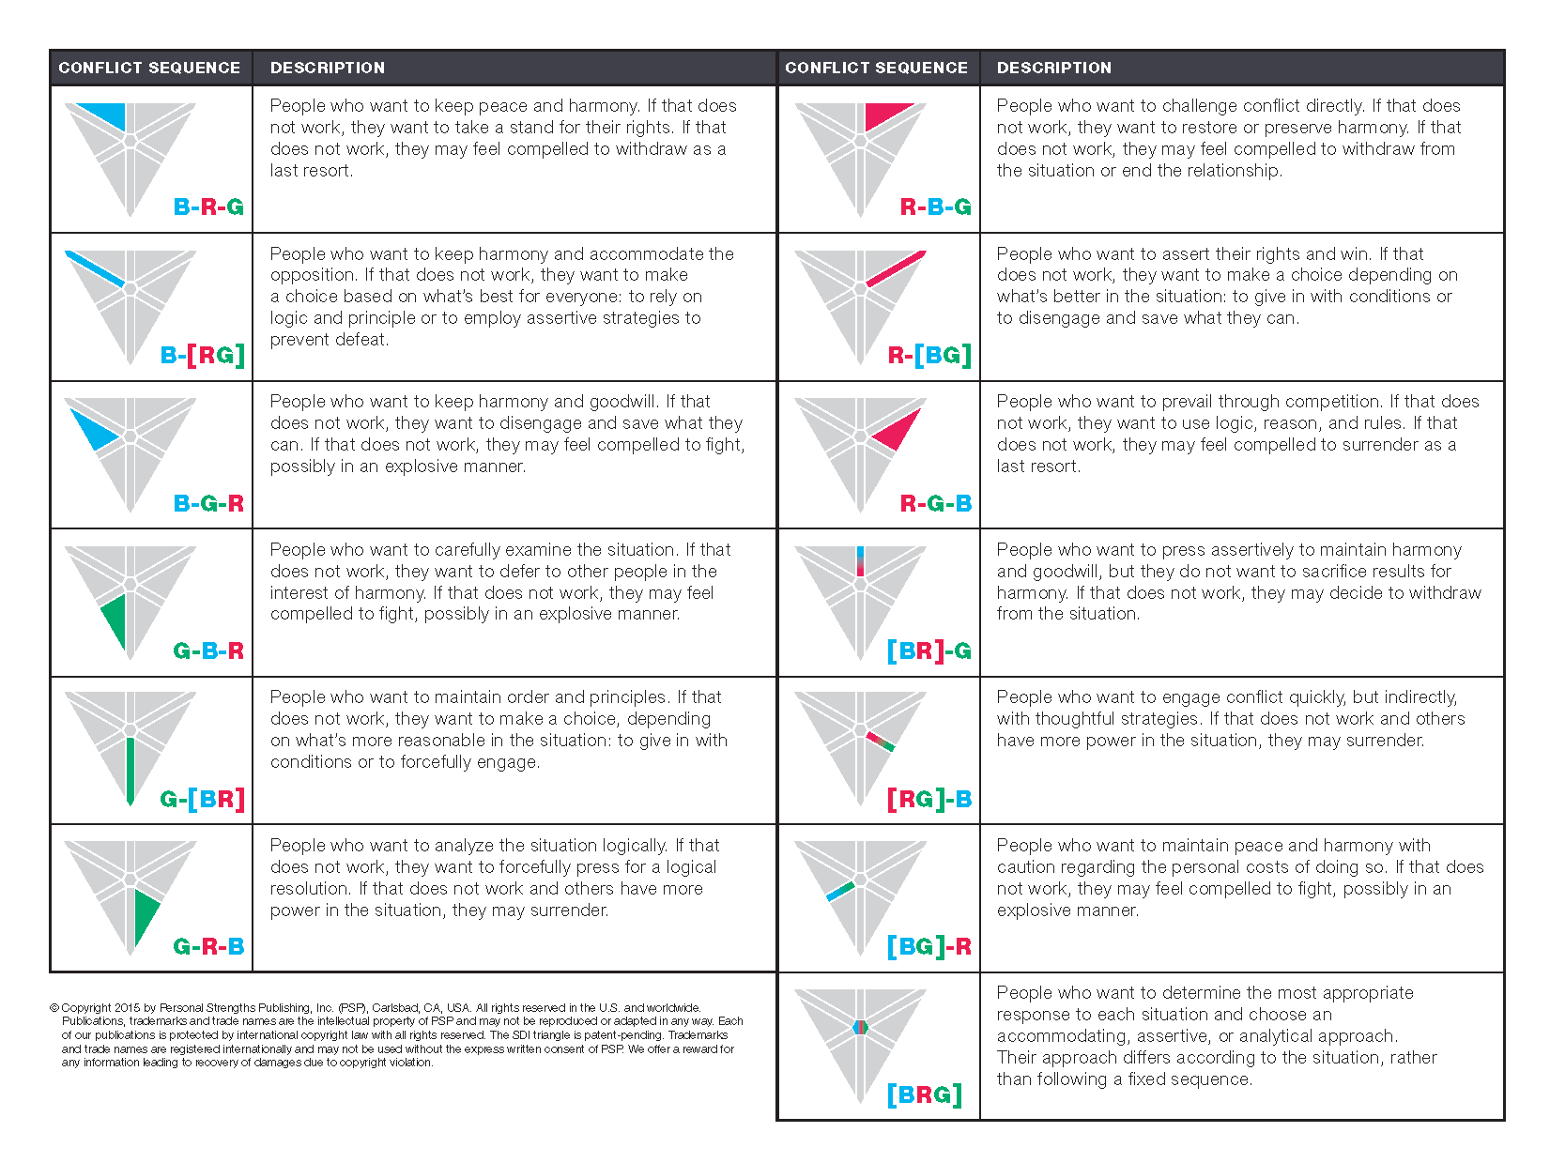
Conflict Sequences
Is your Conflict Sequence arrowhead close to a border?
page 6
Notes:
FACILITATOR: Change page number to align with the interpretive materials you are providing in the session

Slide 59
Arrow Facts:
The Line
A
B
Line Length = Degree of change
in motives from MVS to Stage 1
C
LENGTH | CHANGE | ARROW | MVS | STAGE 1
Long | more noticeable change | A | Red | Blue
Medium | somewhat noticeable change | B | Blue-Green | Green
Short | less noticeable change | C | Green | Green

Slide 60
B-R-G
R-B-G
B-[RG]
[BR]-G
R-[BG]
The 13
CS Types
B-G-R
[BRG]
R-G-B
[BG]-R
[RG]-B
G-B-R
G-R-B
Over 5,000 possible
CS arrowheads
13 CS regions group all the
CS arrowheads that are similar
Some CS arrowheads are
close to borders
G-[BR]

Slide 61
Arrow Facts:
Brackets
6pt.
53
26
21
[
]
Brackets mean
about equal
B - R - G

Slide 62

Changing Focus
During Conflict
OTHERS
OTHERS
PROBLEM
PROBLEM
STAGE 1
STAGE 3
STAGE 2
SELF

Slide 63
The Building Blocks of Conflict Sequences
CONFLICT STAGE | FOCUS ON | BLUE Accommodate | RED Assert | GREEN Analyze
1 | Self, Problem, & Others | Wanting to accommodate others | Wanting to assert oneself | Wanting to analyze the situation
2 | Self, Problem, & Others | Wanting to conditionally give in or defer to others | Wanting to prevail against the issue or others | Wanting to disengage from others or clarify the issue
3 | Self, Problem, & Others | Feeling driven to give up | Feeling driven to fight | Feeling driven to retreat

Slide 64
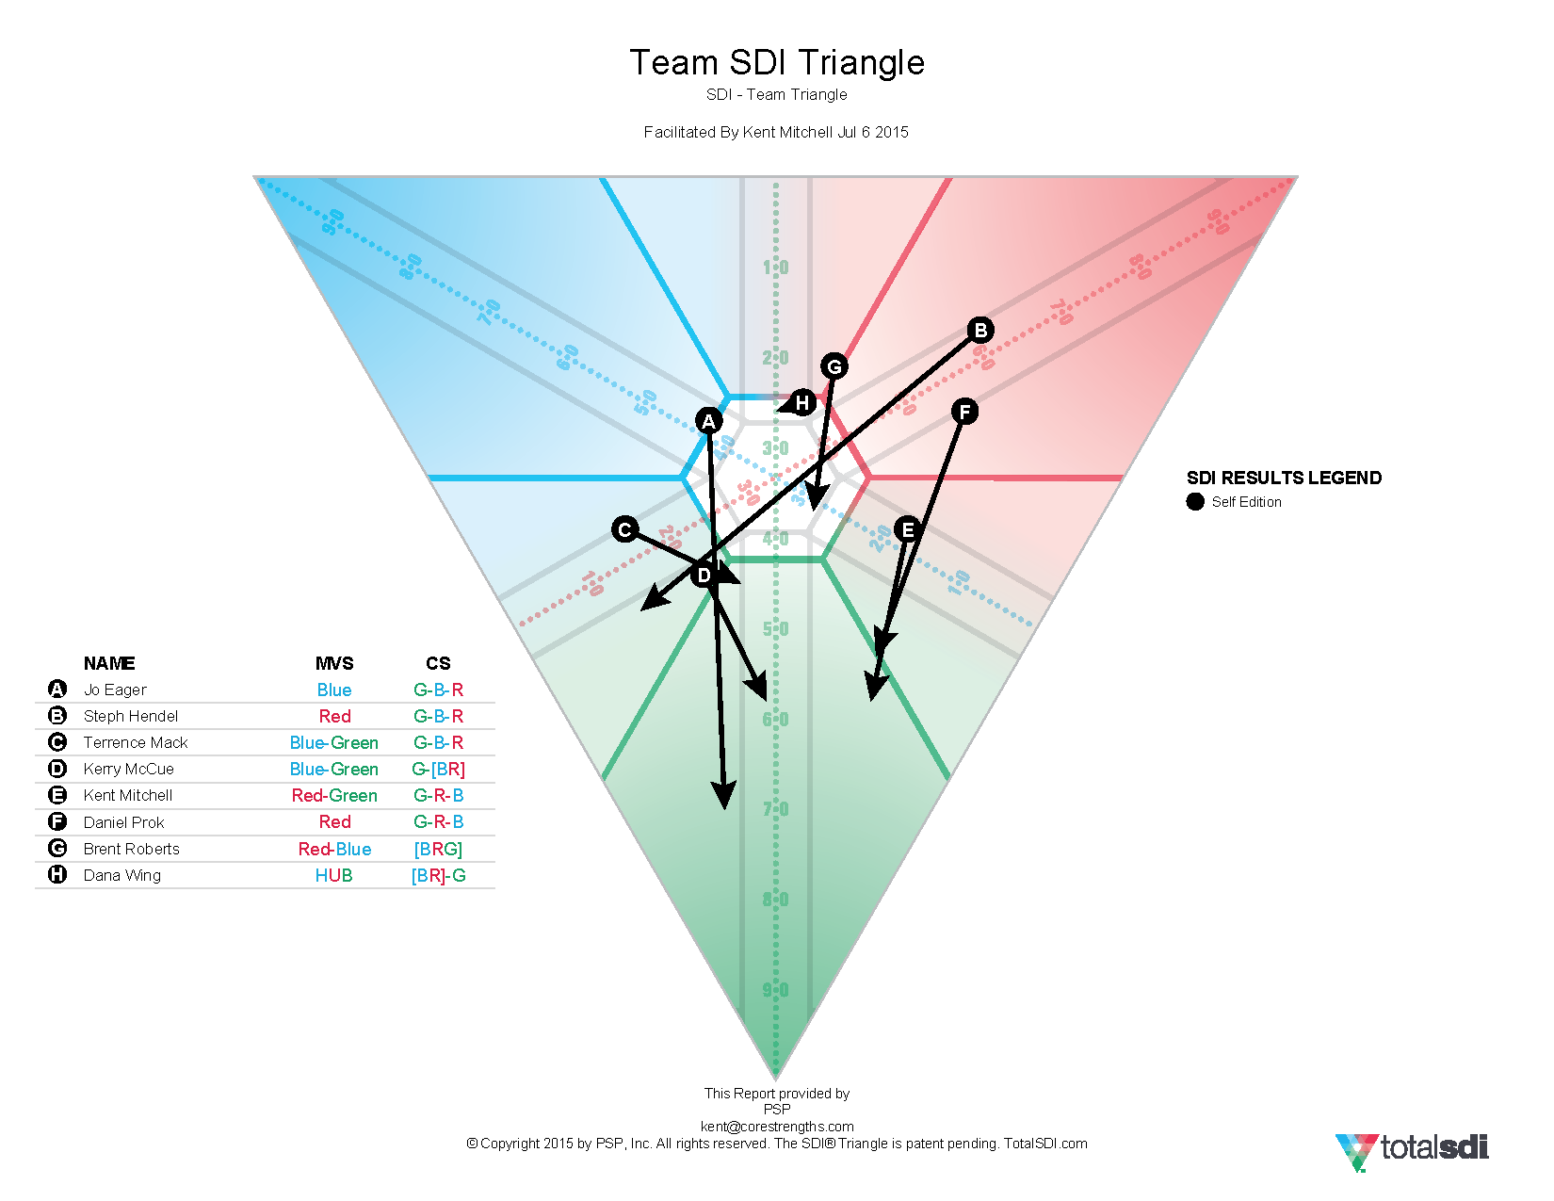
Our Team
SDI Triangle
Notes:
FACILITATOR: Place the team SDI triangle with full arrows

Slide 65
Living Triangle:
Conflict
4-Step Activity
Stage 1
Conflict Groups
Stage 2
Conflict Groups
Stage 3
Conflict Groups
MVS Groups

Slide 66
Living Triangle:
Stage 1 Conflict
(Stage 1 Color)
What we do...
How we feel...
What we want...
When approaching us...
DO DON’T

Slide 67



Stage 1 Blue
People who want
to accommodate the opposition and to maintain peace, harmony, and goodwill.
ACCOMMODATE

Slide 68



Stage 1 Red
People who want
to assert their rights, to challenge conflict directly, and to prevail through competition.
ASSERT

Slide 69



Stage 1 Green
People who want
to analyze the situation carefully and logically, to maintain order and principles.
ANALYZE

Slide 70

Stage 1 [BR]
People who want to press assertively to maintain harmony and good will, but who do not want to sacrifice results for harmony.
[
]
ACCOMMODATE
ASSERT

Slide 71

Stage 1 [RG]
People who want to engage conflict quickly, but indirectly, with thoughtful strategies.
[
]
ASSERT
ANALYZE

Slide 72

Stage 1 [BG]
People who want to maintain peace and harmony with caution regarding the personal cost of doing so.
[
]
ACCOMMODATE
ANALYZE

Slide 73

Stage 1 [BRG]
People who want to determine the most appropriate response to each situation and choose an accommodating, assertive, or analytical approach.
[
]
ACCOMMODATE
ASSERT
ANALYZE

Slide 74
Stage 2
Conflict
Stage 2 [BR]
Defer to others,
and/or assert rights
Stage 2 Blue
Accommodate
with conditions or make peace
Stage 2 Red
Confront to win or enforce rights
Stage 2 [BRG]
Yield, confront,
and/or reconsider depending on the situation
Stage 2 [BG]
Yield on minor aspects,
accommodate and/or analyze
Stage 2 [RG]
Use the rules to win, assert, and/or analyze
How well do these statements describe what you do when
you are in Stage 2 conflict?
Stage 2 Green
Back off and reconsider or
Re-evaluate means and ends

Slide 75
Stage 3
Conflict
Stage 3 [BR]
Give up or argue
Stage 3 Blue
Surrender the issue or admit defeat
Stage 3 Red
Make a strong, final stand and argument
Stage 3 [BRG]
Give up, withdraw,
or argue depending on the situation
Stage 3 [BG]
Withdraw or
give up
Stage 3 [RG]
Argue or withdraw
Stage 3 Green
Withdraw or detach
How well do these statements describe what you do when you are in Stage 3 conflict?

Slide 76
Path Back to MVS
People and Performance
People
Performance
People, Performance, and Process
People and Process
Performance and Process
Resolving conflict gets
people back to their MVS
The path from conflict back to MVS starts with identifying what people are most concerned about.
Process

Slide 77
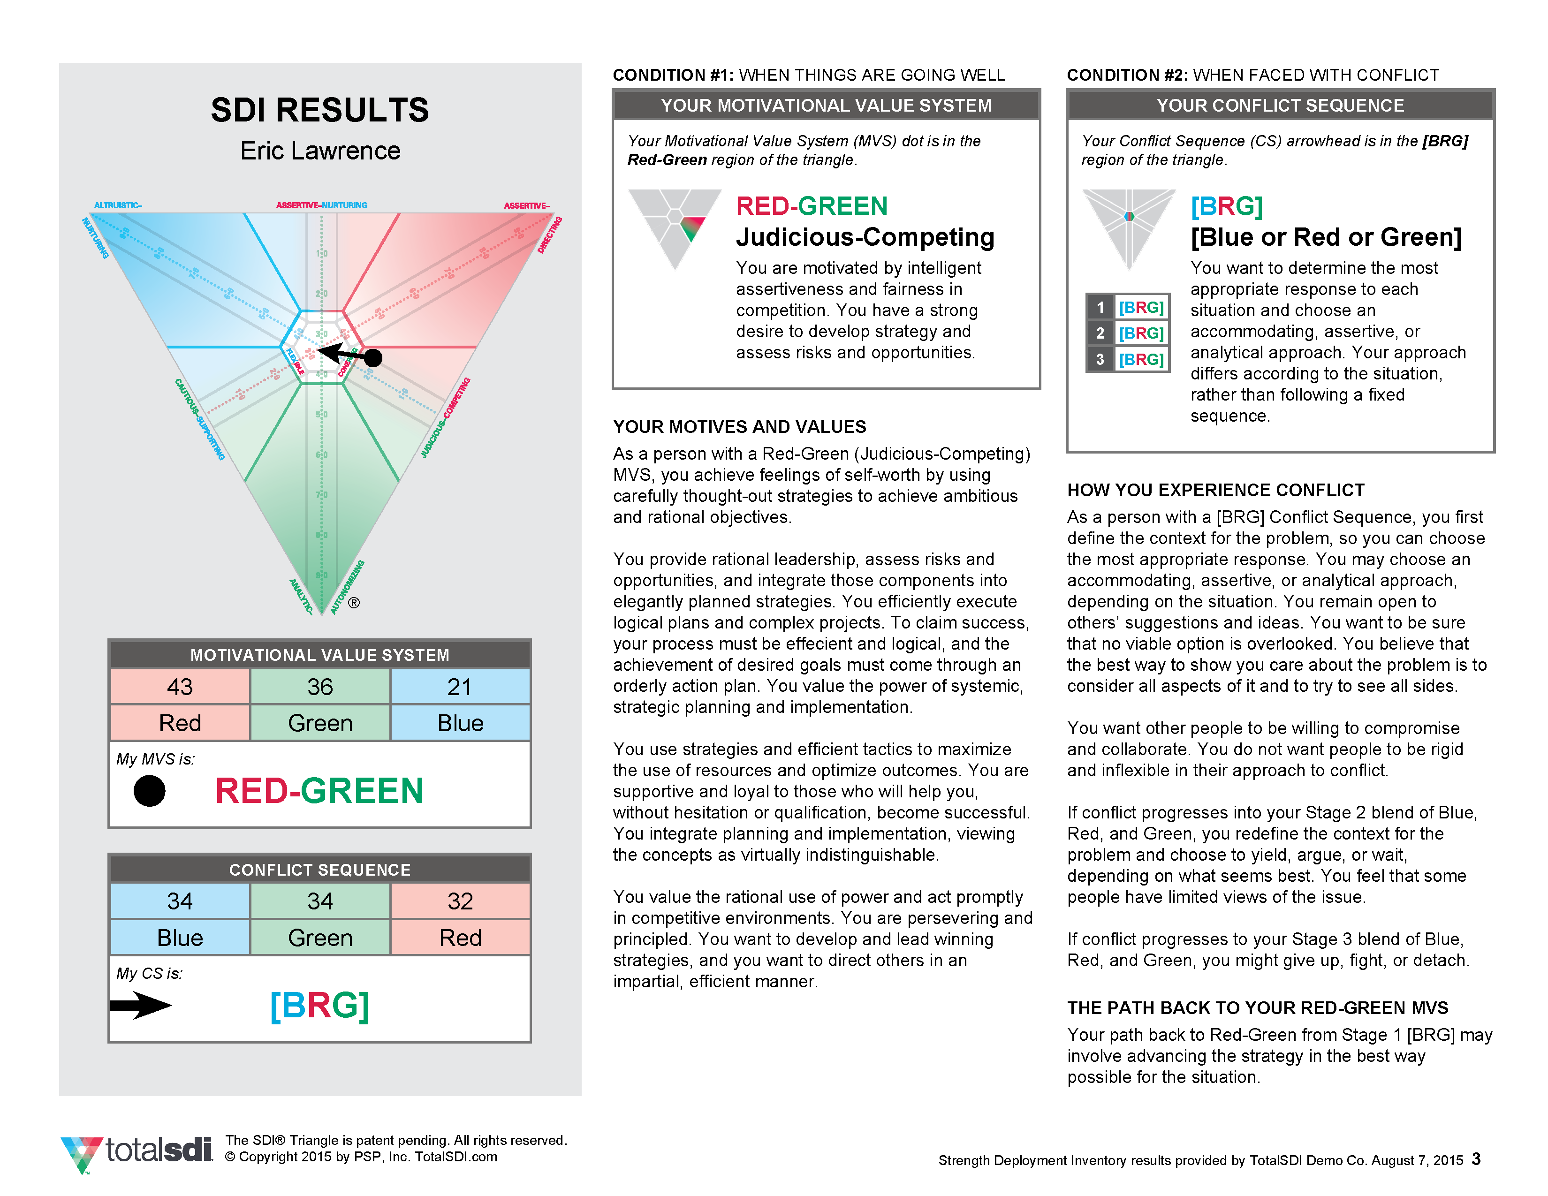
Complete SDI
Results
Notes:
FACILITATOR: Place your own SDI report (full arrow)

Slide 78
Path Back to MVS
Thinking about People
and how to help
Thinking about Performance and what to do
Thinking about Perspective
and keeping options open
Stage 1 Green
Resolving conflict involves “connecting the dots”
...getting back to the MVS.
Thinking about Process and what is logical

Slide 79
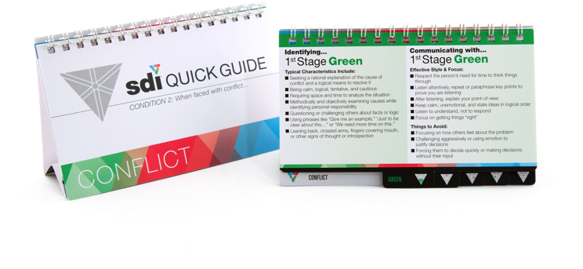
Effective Communication
During Conflict
Refer to your CS page
Do the “Effective Style & Focus” points offer good advice to others about how
to work with you?
Read the “Things to Avoid” points. How do you react when others approach you in these ways?
Refer to the page
for the CS of a key relationship.
Read the “Effective Style & Focus” points and “Things to Avoid” points.
What could you do (or not do) to work more effectively with this person?

Slide 80
6
Team Effectiveness
TEAM PORTRAIT CARDS
Behavior is driven by motives
Motives change in conflict
Strengths can be overdone
Filters influence perception

Slide 81
Effective teams understand the relationships between...
Motives
Conflict
Strengths
Filters

Slide 82
Our Team
SDI Triangle
Notes:
FACILITATOR: Place the team SDI Triangle again (full arrows)

Slide 83
Team
Summary
Awareness
What we
learned...
Effectiveness
What we
will do...

Slide 84
Going
Forward
SDI and strengths in
everyday conversation
Follow-up or expanded activities
Feedback
Expectations
Coaching/Consulting

Slide 85

LearnerSource
www.LearnerSource.com
Log in with your code
(or “register with your e-mail address”)
Get reports & resources
Notes:
Are you conducting your session using paper or online assessments? Change the login instructions to fit your format.

Slide 86
Workshop Title
Client Name : Program Name
Presented by:
Your Name
Event Date
Your Logo

